Slide 1
Virtual Shopping cart
Overview of the Shopping Cart Code
This is Ankit Ojha.
B.Tech (IT) 3rd year

Slide 2
Introduction:
This program simulates a shopping cart system.
Allows users to add, update, and remove items from the cart.
Displays the total cost of items.
Uses the PrettyTable library for displaying tabular data.
Here are the function names used in the given program:
totalCost()
printCartItems()
addItemInCart(itemName, itemPrice, selector_id)
getValidSelectedItem(selector_id)
getQuantity()
updateCart(selected_id, item_name, price, quantity)
addToDatabase(selected_id, item_name, price, quantity)
removeItemFromCart()
checkForRemove()
printShopItems(items)
main()

Slide 3
getValidSelectedItem(Selector_id)
: Validate Item Id and return valide selection
checkForremove():
Ask From the user
start
No
Yes
If they want to remove Item form the cart
Define global Database:
ItemInCart[ ]
getQuantity( ):
Loop: Ask user for a Valid Quantity Validate Postive Number Input
Main()
UpdateCart(selected_id,
Item_name,price, qty):
If item exists in cart:
Update Quantity and total
Else: Add new Item to the cart
RemoveItemFromCart( ):
Show current card and remove selected id:
Define Shop Items:
Dictonary of –Itemname ,ItemPrice
printCartItem( ):
Final cart displayed with totalcost
printshopItems(ShopItem):
prettyTable prints shop items
(so. , Item _Name,Price , selector_Id)
totalCost( ):
Return total cost
addItemIncart ():
Loop: select item by ‘ID’ and
Add items to cart.
Stop
printCartItem():
PrattyTable Shows selected items in cart and totalcost
false
true
Select(-1)

Slide 4

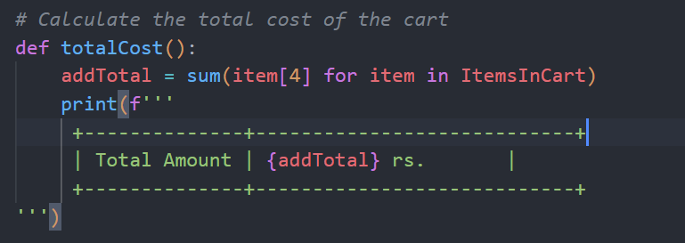
Global Database & totalCost Function
Global Database: ItemsInCart: A global list to store the items added by the user.
totalCost () Function:
Sums up the total cost of all items in the cart.
Displays the total cost in a simple table format.

Slide 5
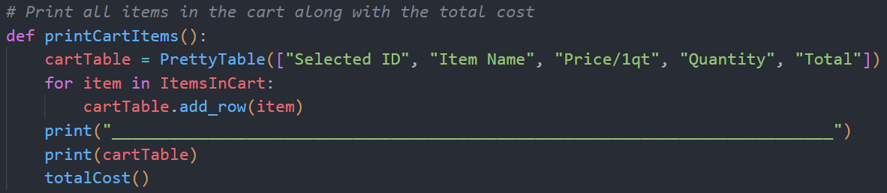
printCartItems () Function
printCartItems () :
Uses PrettyTable to format and print all items in the cart.
Displays item ID, name, price, quantity, and total price.
Calls the totalCost() function to show the final amount.

Slide 6
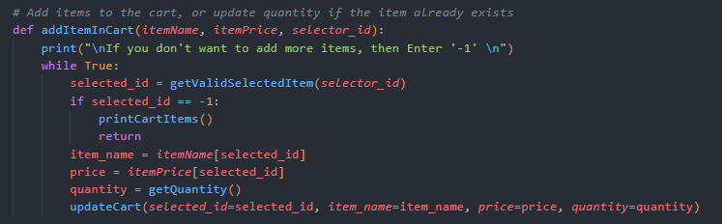
addItemInCart () Function
This function allows users to:
Add items to the cart based on the item ID.
Enter the quantity of the selected item.
If the item is already in the cart, it updates the quantity.
Loops until the user chooses to stop by entering -1
This function calls to another Function:
getValidSelectedItem(selector_id)
getQuantity()

Slide 7
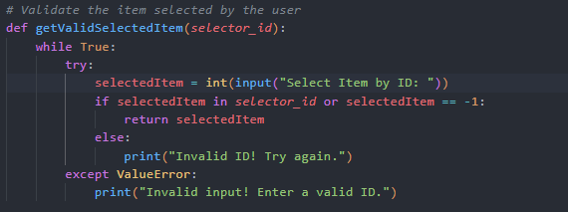
getValidSelectedItem () Function
This function allows users to:
Purpose: To validate user input for selecting an item.
How it works:
Prompts the user to enter an item ID.
Checks if the selected ID is valid or if the user wants to exit (by entering -1).
Returns the selected item ID if valid.

Slide 8
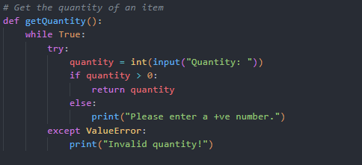
getQuantity () Function
This function works:
Ensures the user enters a valid, positive quantity.
Loops until the user inputs a valid number.
Returns the entered quantity for further use.

Slide 9
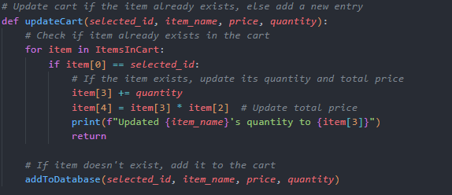

updateCart ()Function
This function works:
Purpose: To either update the quantity of an existing item in the cart or add a new one.
If the item already exists in the cart:
Updates the quantity and recalculates the total price.
Otherwise, it calls addToDatabase() to add the new item to the cart.

Slide 10
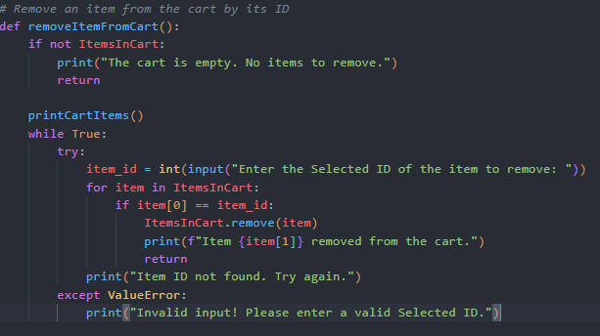
removeItemFromCart () Function
This function works:
Purpose: Allows users to remove an item from the cart.
It first prints the current cart items.
The user enters the selected item ID to remove the item.
If the item ID is valid, it removes the item from the cart.

Slide 11
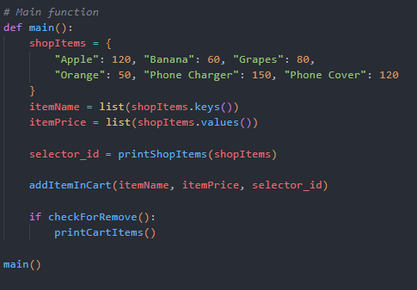
Main () Function
This function works:
Entry point:
Initializes the available shop items.
Calls the necessary functions to add items and optionally remove them.
Uses PrettyTable to display available and selected items.
This function calls to another function:
printShopItem()
addItemInCart()
checkForRemove()
printCartItems()

Slide 12
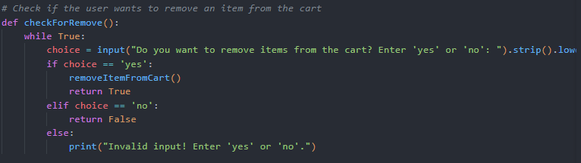
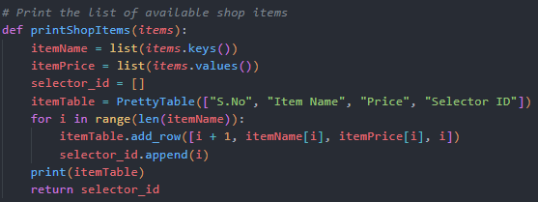

Slide 13
THANK YOU !

